Slide 1
Circular and doubly linked list

Slide 2
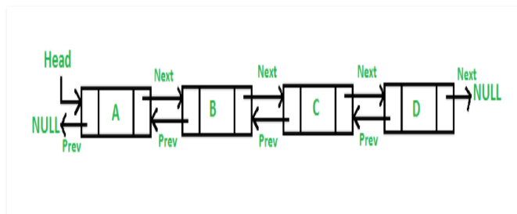
DOUBLY LINKED LIST
A Doubly Linked List (DLL) contains an extra pointer, typically called previous pointer, together with next pointer and data which are there in singly linked list.

Slide 3
Doubly linked list - Creation
public class Node
{
public int data;
public Node prev;
public Node next;
// Constructor to create a new node
// next and prev is by default initialized as null
Node(int d) { data = d; }
}
public class DLL
{
Node head; // head of list
}

Slide 4
Doubly linked list - TRAVERSAL
public void printlist(Node node)
{
Node last = null;
Console.WriteLine("Traversal in forward Direction");
while (node != null) {
Console.Write(node.data + " ");
last = node;
node = node.next;
}
Console.WriteLine();
Console.WriteLine("Traversal in reverse direction");
while (last != null) {
Console.Write(last.data + " ");
last = last.prev;
}

Slide 5
DLL- INSERTION
Insertion A node can be added in four ways 1) At the front of the DLL 2) After a given node. 3) At the end of the DLL 4) Before a given node.

Slide 6
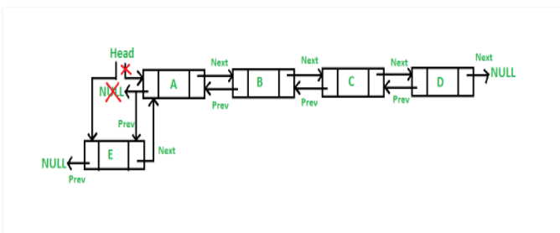
DLL –insertion at front
The new node is always added before the head of the given Linked List. And newly added node becomes the new head of DLL. For example if the given Linked List is 10152025 and we add an item 5 at the front, then the Linked List becomes 510152025. Let us call the function that adds at the front of the list is push().

Slide 7
DLL –insertion at front
public void push(int new_data)
{
/* 1. allocate node
* 2. put in the data */
Node new_Node = new Node(new_data);
/* 3. Make next of new node as head and previous as NULL */
new_Node.next = head;
new_Node.prev = null;
/* 4. change prev of head node to new node */
if (head != null)
head.prev = new_Node;
/* 5. move the head to point to the new node */
head = new_Node;
}

Slide 8
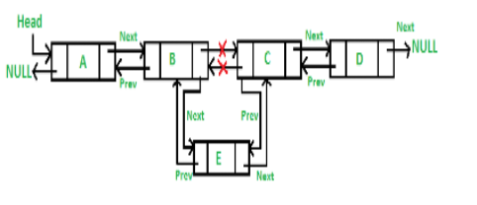
DLL – Add node after given node
We are given pointer to a node as prev_node, and the new node is inserted after the given node.

Slide 9
DLL – Add node after given node
/* 4. Make next of new node as next of prev_node */
new_node.next = prev_Node.next;
/* 5. Make the next of prev_node as new_node */
prev_Node.next = new_node;
/* 6. Make prev_node as previous of new_node */
new_node.prev = prev_Node;
/* 7. Change previous of new_node's next node */
if (new_node.next != null)
new_node.next.prev = new_node;
}
public void InsertAfter(Node prev_Node, int new_data)
{
/*1. check if the given prev_node is NULL */
if (prev_Node == null) {
Console.WriteLine("The given previous node cannot be NULL ");
return;
}
/* 2. allocate node
* 3. put in the data */
Node new_node = new Node(new_data);

Slide 10
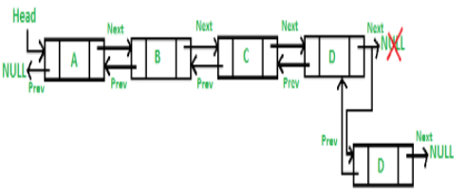
DLL – Add node at the end
The new node is always added after the last node of the given Linked List. For example if the given DLL is 510152025 and we add an item 30 at the end, then the DLL becomes 51015202530. Since a Linked List is typically represented by the head of it, we have to traverse the list till end and then change the next of last node to new node.

Slide 11
DLL – Add node at the end
void append(int new_data)
{
/* 1. allocate node
* 2. put in the data */
Node new_node = new Node(new_data);
Node last = head; /* used in step 5*/
/* 3. This new node is going
to be the last node, so
* make next of it as NULL*/
new_node.next = null;
/* 4. If the Linked List is empty,
then make the new * node as head */
if (head == null)
{
new_node.prev = null;
head = new_node;
return;
}
/* 5. Else traverse till the last node */
while (last.next != null)
last = last.next;
/* 6. Change the next of last node */
last.next = new_node;
/* 7. Make last node as previous of new node */
new_node.prev = last;
}

Slide 12
DLL – Add a node before a given node:
Let the pointer to this given node be next_node and the data of the new node to be added as new_data.
Check if the next_node is NULL or not. If it’s NULL, return from the function because any new node can not be added before a NULL
Allocate memory for the new node, let it be called new_node
Set new_node->data = new_data
Set the previous pointer of this new_node as the previous node of the next_node, new_node->prev = next_node->prev
Set the previous pointer of the next_node as the new_node, next_node->prev = new_node
Set the next pointer of this new_node as the next_node, new_node->next = next_node;
If the previous node of the new_node is not NULL, then set the next pointer of this previous node as new_node, new_node->prev->next = new_node
Else, if the prev of new_node is NULL, it will be the new head node. So, make (*head_ref) = new_node.

Slide 13
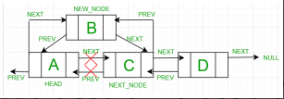
DLL – Add a node before a given node:

Slide 14
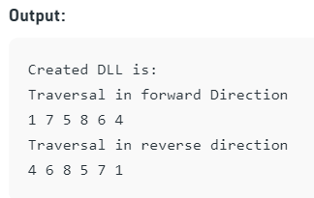
DLL – main method final call
/* Start with the empty list */
DLL dll = new DLL();
// Insert 6. So linked list becomes 6->NULL
dll.append(6);
// Insert 7 at the beginning.
// So linked list becomes 7->6->NULL
dll.push(7);
// Insert 1 at the beginning.
// So linked list becomes 1->7->6->NULL
dll.push(1);
// Insert 4 at the end. So linked list
// becomes 1->7->6->4->NULL
dll.append(4);
// Insert 8, after 7. So linked list
// becomes 1->7->8->6->4->NULL
dll.InsertAfter(dll.head.next, 8);
Console.WriteLine("Created DLL is: ");
dll.printlist(dll.head);

Slide 15
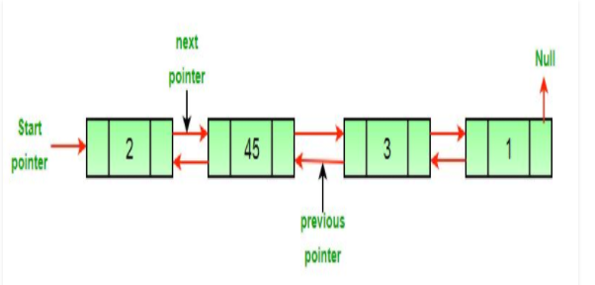
DLL – delete a node

Slide 16
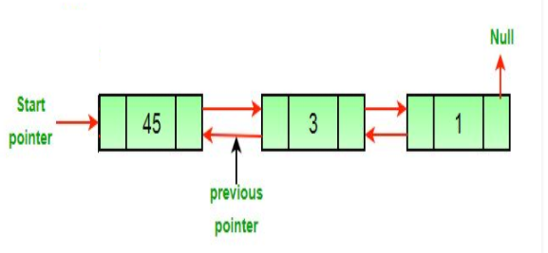
DLL – delete a node
Approach: The deletion of a node in a doubly-linked list can be divided into three main categories:
After the deletion of the head node.

Slide 17
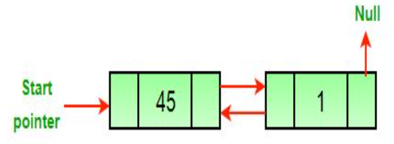
DLL – delete a node
After the deletion of the middle node.

Slide 18
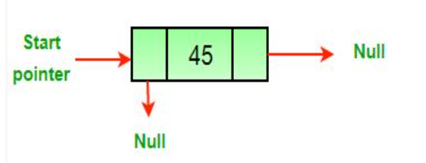
DLL – delete a node
After the deletion of the last node.

Slide 19
DLL – delete a node
All three mentioned cases can be handled in two steps if the pointer of the node to be deleted and the head pointer is known.
If the node to be deleted is the head node then make the next node as head.
If a node is deleted, connect the next and previous node of the deleted node.

Slide 20
DLL – delete a node
Algorithm
Let the node to be deleted be del.
If node to be deleted is head node, then change the head pointer to next current head.
if headnode == del then headnode = del.nextNode
Set next of previous to del, if previous to del exists.
if del.nextNode != none del.nextNode.previousNode = del.previousNode
Set prev of next to del, if next to del exists.
if del.previousNode != none del.previousNode.nextNode = del.next

Slide 21
DLL – delete a node
void deleteNode(Node del)
{
// Base case
if (head == null || del == null)
{
return;
}
// If node to be deleted is head node
if (head == del)
{
head = del.next;
}
// Change next only if node to be deleted
// is NOT the last node
if (del.next != null)
{
del.next.prev = del.prev;
}
// Change prev only if node to be deleted
// is NOT the first node
if (del.prev != null)
{
del.prev.next = del.next;
}
// Finally, free the memory occupied by del
return;
}

Slide 22
DLL – delete a node, final main calling
/ Deleting middle node from 8->4->2
dll.deleteNode(dll.head.next);
Console.Write("\nList after Deleting middle node: ");
dll.printlist(dll.head);

Slide 23
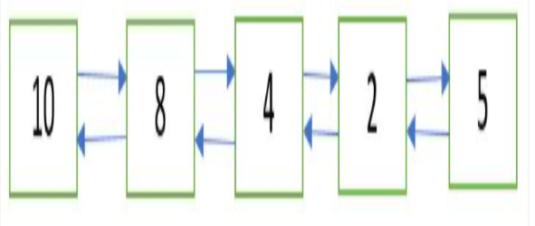
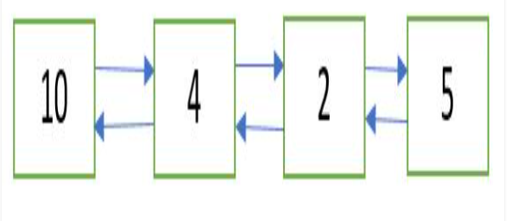
DLL – delete a node, at given position
Given a doubly linked list and a position n. The task is to delete the node at the given position n from the beginning. Initial doubly linked list
Doubly Linked List after deletion of node at position n = 2

Slide 24
DLL – delete a node, at given position
Approach: Following are the steps:
Get the pointer to the node at position n by traversing the doubly linked list up to the nth node from the beginning.
Delete the node using the pointer obtained in

Slide 25
DLL – delete a node, at given position
static void deleteNodeAtGivenPos(Node head, int n)
{
/* if list in NULL or invalid position is given */
if (head == null || n <= 0)
return;
Node current = head;
int i;
/*
* traverse up to the node at position 'n' from the beginning
*/
for (i = 1; current != null && i < n; i++)
{
current = current.next;
}
// if 'n' is greater than the number of nodes
// in the doubly linked list
if (current == null)
return;
// delete the node pointed to by 'current'
deleteNode(head, current);
}

Slide 26
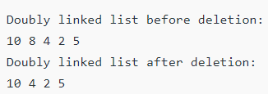
DLL – delete a node, at given position
// Start with the empty list
Node head = null;
// Create the doubly linked list:
// 2<->2<->10<->8<->4<->2<->5<->2
head = push(head, 2);
head = push(head, 5);
head = push(head, 4);
head = push(head, 8);
head = push(head, 10);
Console.WriteLine("Doubly linked list before deletion:");
printList(head);
int n = 2;
// delete node at the given position 'n'
deleteNodeAtGivenPos(head, n);
Console.WriteLine("Doubly linked list after deletion:");
printList(head);

